Slide 1


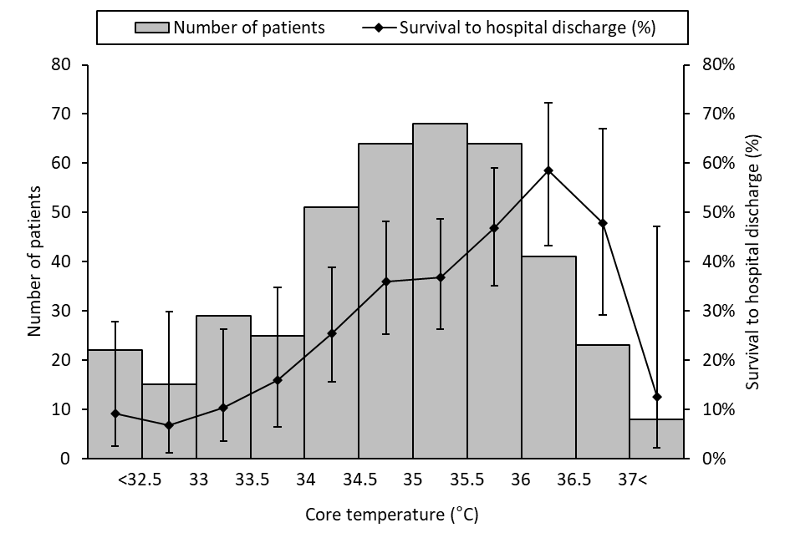


Pre-hospital core body temperature is associated with increased survival to discharge in out of hospital cardiac arrests (OHCA): a retrospective observational study.
USE THIS SPACE FOR YOUR MAIN MESSAGE
M. Clough ¹, E. Butterfield ², Z. Starr ², S. Aziz ², K. Lachowycz ²
1. Newcastle University School of Medicine, Newcastle upon Tyne, UK
2. Department of Research, Audit, Innovation, and Development, East Anglian Air Ambulance, Norwich, UK
Authors
  Background
Despite multiple studies showing that lower core body temperature on arrival to hospital after OHCA are associated with poorer outcomes, there have been no studies investigating this relationship using pre-hospital core temperatures. The aim of this retrospective observational study was to investigate the relationship between core body temperature in OHCA patients after return of spontaneous circulation (ROSC) and survival to discharge.
  Methods
  Results
A retrospective database review was conducted of all cardiac arrest patients attended by East Anglian Air Ambulance (EAAA) between 1st February 2016 and 31st March 2023.
Routinely collected data, including oesophageal temperature readings from the Zoll monitor and outcome data, were extracted from the electronic patient record HEMSbase. The inclusion criteria were: >18 years of age, medical cardiac arrest, ROSC anytime and ≥4 post-ROSC oesophageal temperatures.
A pre-defined significance value of p<0.05 was used throughout. Logistic regression was used to test the association between the first post-ROSC oesophageal temperature and survival to discharge.
The database included 3114 OHCA patients attended by EAAA, of which 410 patients met the inclusion criteria. Of these patients, 137 (33.5%) survived to discharge.
Age ranged from 18 to 91 with a mean age of 61. The mean pre-hospital oesophageal core temperature was 34.7°C (95% CI 34.6 – 34.9). Logistic regression showed a statistically significant association between first post-ROSC oesophageal temperature and survival (p <0.001), with an odds ratio of 1.52 (95% confidence interval 1.28-1.84) for each degree increase in temperature.
The patients with highest survival to discharge rates were those with first oesophageal temperatures of 36.0-36.9 degrees.
  Conclusion
The results demonstrate an association between the first recorded oesophageal temperature and survival to discharge. This suggests that oesophageal temperature may be a useful indicator of patient prognosis. However, further research is required to validate this association.
Contact:
Emma.Butterfield@eaaa.org.uk

